Slide 1

RENTAL CAR APP
Presented by:
Maryam Fareed
Youmna Saifullah

Slide 2
INTRODUCTION

Slide 3
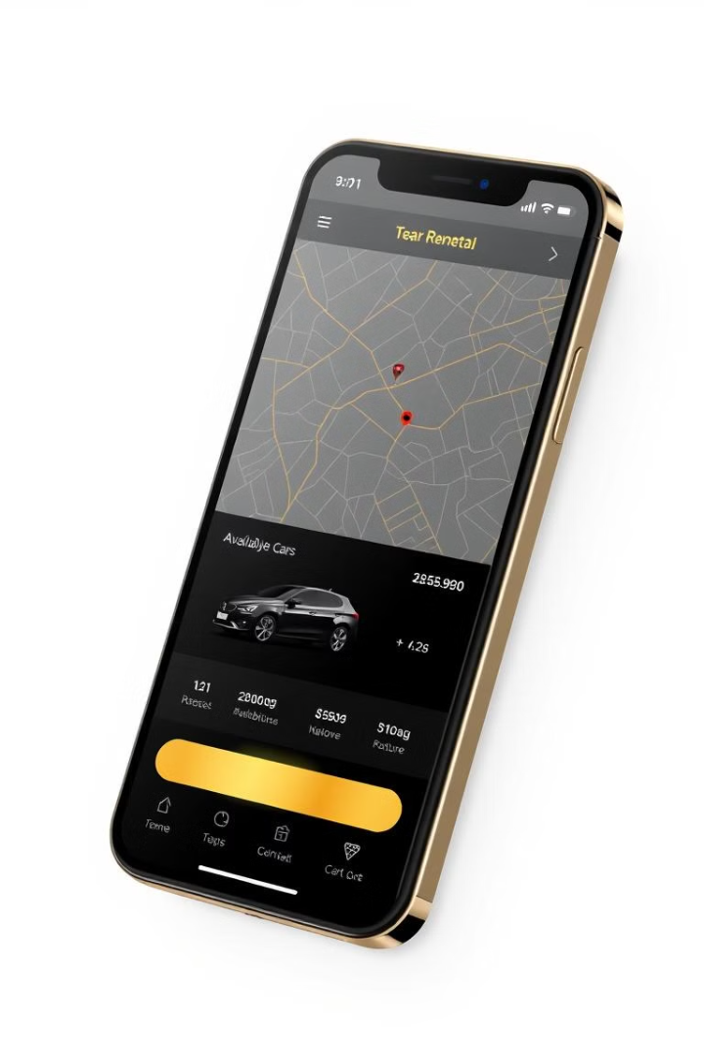
RENTAL CAR APP IN FLUTTER USING OOPS
Our app simplifies the car rental process, offering users a seamless and enjoyable experience while ensuring scalability and maintainability through OOP principles.

Slide 4
OVERVIEW

Slide 5
Overview of Rental Car App
Simplified Rental Process
User-Centric Design
Streamlined rental experience for effortless car browsing, comparison, and booking
Modern solution that removes the hassles of traditional rental agencies
User-friendly design with an intuitive interface.
Easy and straightforward navigation for all users.
Focused on delivering a simple, accessible experience.

Slide 6
PRINCIPLES

Slide 7




Object-Oriented Programming (OOP) Principles in Flutter
1
Encapsulation
2
Inheritance
3
Polymorphism
4
Abstraction

Slide 8
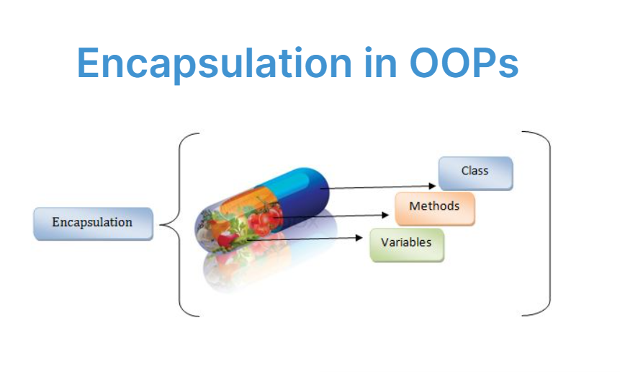
Encapsulation:
1
Encapsulation in Authentication (Authservice class)
2
Encapsulation of Car data(Car Model)
3
Encapsulation in UI Components(Controller and Input Handling)
4
Encapsulation in State Management(CarBloc)
5
Encapsulation in Widge-Based Structure(UI Screens and Logic)

Slide 9
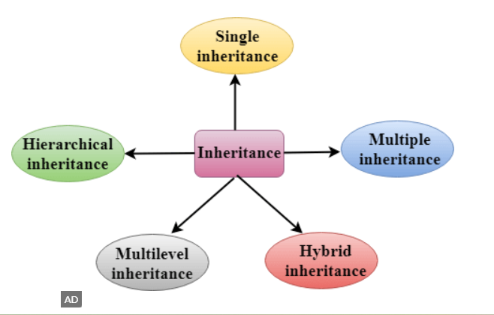
Inheritance:
1
Login page inherits from Stateless Widget
2
Car Detail Page Inherits from StatefulWidget
3
MapDetailsPage Inherits Stateless Widget
4
Reusing ElevatedButton in Multiple Pages
5
Inherited Widges for Global Themes

Slide 10
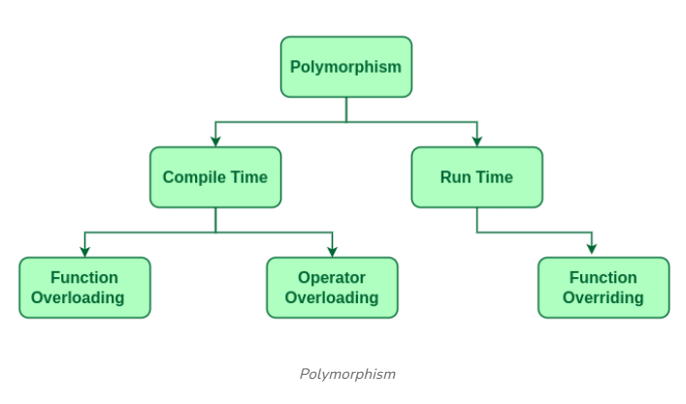
Polymorphism:
1
Custom Widges (CarCard Widges)
2
Stateless and Stateful Widge override
3
Polymorphism UI with Listview.builder
4
Usage of Authservice Class with Different User Types
5
Overriding Animation Behaviour in Car Detail Page

Slide 11
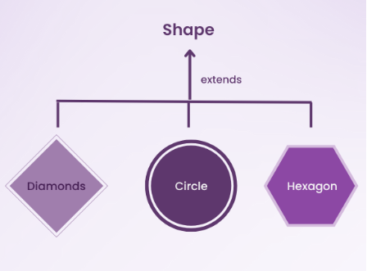
Abstraction:
1
Abstraction in AuthService class
2
Car Model Class Abstracts Car Data
3
UI Abstraction with Staeless and Stateful Widges
4
Abstracting Map features in Map Detail Page
5
Abstraction in Bussiness Logic( Car bloc State Management)

Slide 12
SYSTEM ARCHITECTURE

Slide 13
System Architecture
Frontend
1
User-friendly interface built with modern technologies for a seamless experience.
Backend
2
Secure and robust backend infrastructure for data management and processing.
Database
3
Reliable database to store user data, car information, and booking details.
API
4
API integration with car rental companies for real-time data and booking confirmations.

Slide 14
BOARDING PAGE

Slide 15
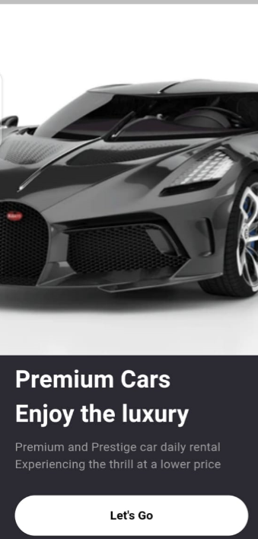
Boarding Page
Custom Background: Uses an image as the background for the onboarding screen.
Text Information: Displays a header and description with distinct styling.
Responsive Button: A full-width "Let's Go" button that navigates to the login page.
Column Layout: Organizes content with Column and Expanded for responsive design.
Navigation: Uses Navigator to go to the login page, clearing the stack.

Slide 16
SIGN-UP PAGE

Slide 17
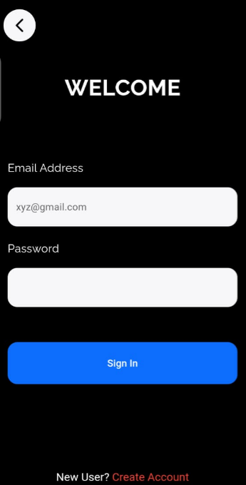
Sign-up Page
AppBar & Background: The AppBar is transparent, with no elevation, and the main background color is set to black.
Sign Up Button: A full-width ElevatedButton is styled with a blue background and triggers the signup function from AuthService when pressed.
Navigation to Login: Below the signup form, a RichText widget provides a link that redirects users to the login page if they already have an account.
Responsive Design: The layout uses a SingleChildScrollView to ensure content is scrollable on smaller screens, with consistent padding for a responsive and user-friendly interface.
User Input Fields: The screen includes email and password fields, styled with GoogleFonts.raleway and a custom InputDecoration for a clean and modern design.

Slide 18
HOME PAGE

Slide 19
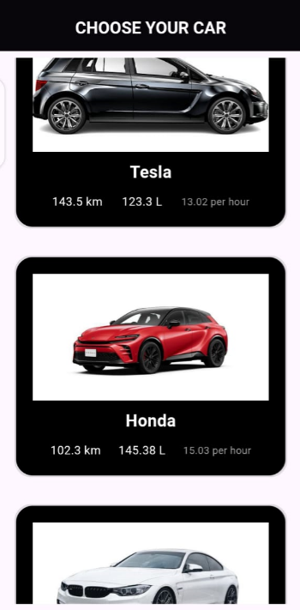
Home Page
AppBar: Displays the title "CHOOSE YOUR CAR" with a black background.
State Management: Utilizes BlocBuilder to handle car data states.
Loading State: Shows a spinner while car data is being fetched.
Loaded State: Displays a list of cars with images using ListView.builder after successful data retrieval.
Error State: Informs users with an error message if data loading fails.

Slide 20
CAR DETAIL PAGE

Slide 21
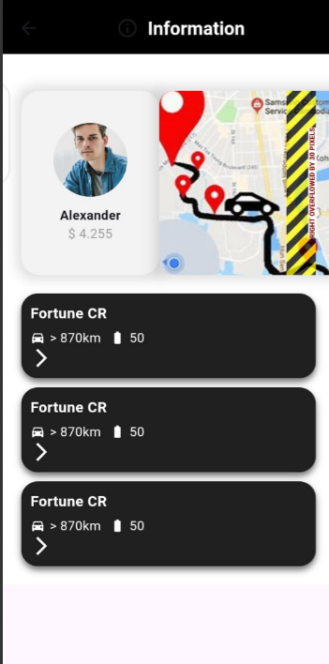
Car Detail Page
Car Details: Displays a profile avatar, owner's name, price, and a map image with animation.
Animation Effect: Applies a scale animation for a zoom-in effect on the map image.
Interactive Map: Tapping the map image opens a MapDetailsPage with detailed car information.
Additional Cars: Shows a list of more car options at the bottom using the MoreCard widget.
.

Slide 22
MAP FEATURE PAGE

Slide 23
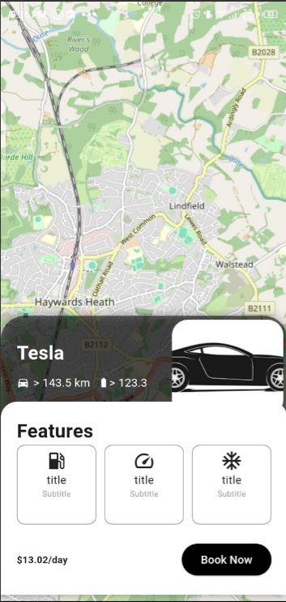
Map Features Page:
Default Map Centering: Map is centered at a default latitude and longitude with zoom controls enabled.
Car Details Widget: A carDetailIsCard widget at the bottom displays specific car details.
Stack Layout: Utilizes a Stack layout, placing the map beneath the car details card.
Map Display: Uses FlutterMap with a tile layer from OpenStreetMap.
Customization: Initial map position and zoom level are customizable via the MapOptions configuration.
.

Slide 24
USER AUTHENTICATION

Slide 25



User Authentication
Login
1
Secure login for existing users.
Sign Up
2
Easy sign-up for new users with social media integration.
Profile Management
3
Manage user profiles, preferences, and past
rental history.

Slide 26
Authentication
Sign In Page
Sign Up Page
Secure login page for existing users with email/password and social media authentication.
Simple and intuitive sign-up page for new users with email, password, and social media integration.

Slide 27
Challenges & Best Practices

Slide 28

Challenges and Best Practices in Developing the Rental Car App
Managing State Across Pages
Ensuring consistent data flow between pages (onboarding, login, car details, map)
Handling Complex UI Layouts
Designing responsive UIs that adapt to screen sizes and orientations, especially with custom animations like map zoom and car details
Integrating Third-Party Libraries and Services
Customizing and troubleshooting third-party libraries (e.g., FlutterMap, Firebase) while managing dependencies and ensuring smooth integration with Flutter.

Slide 29
CONCLUSION & FUTURE ENHANCEMENTS

Slide 30

Conclusion and Future Enhancements
This Flutter rental car app improved UI design, state management, and API handling, overcoming key development challenges. Future updates will include real-time booking, secure payments, AI recommendations, and enhanced performance, ensuring scalability and a seamless user experience.

Slide 31

THANK YOU

